Slide 1
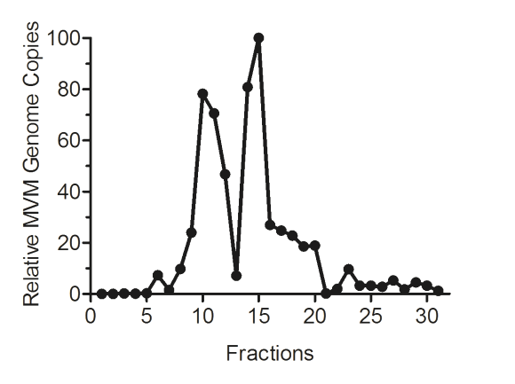
Fig. 1
A
B
C
D
FC-P₁
FC-P₂
7
8
9
10
11
12
13
14
15
16
17
18
19
20

Slide 2
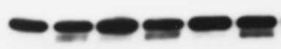
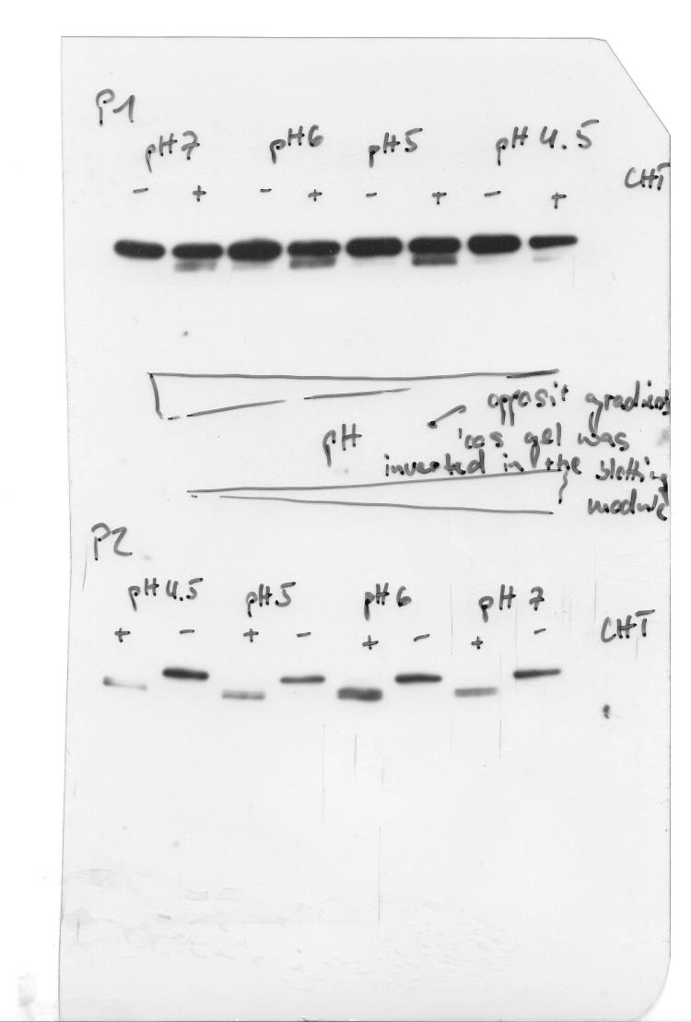
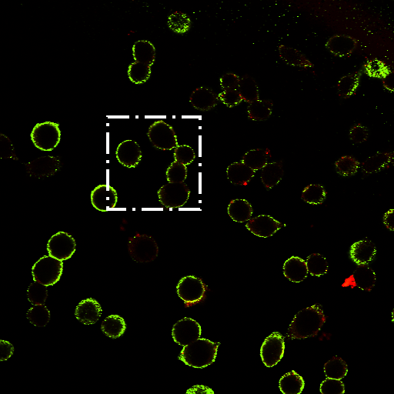
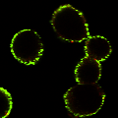
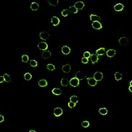
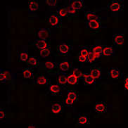
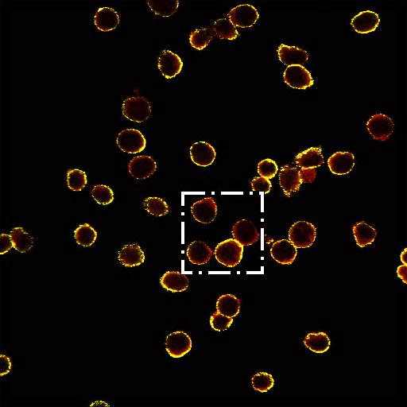
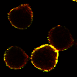
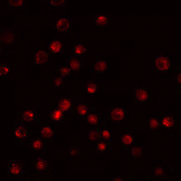
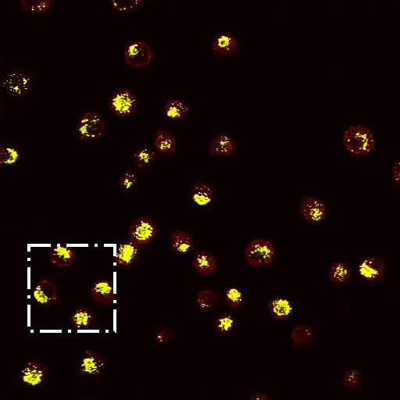
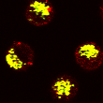
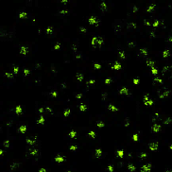
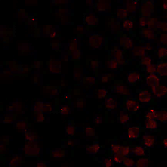
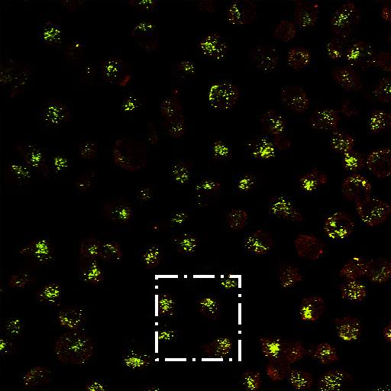
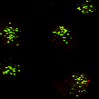
Fig. 2
A
B
C
D
E
pH 7
pH 6
pH 5
-
+
-
+
-
+
CHT
FC-P1
VP2
VP3
FC-P2
VP2
VP3
F
G
α Capsid
α N-VP2
Merge
Detailed
FC-P₁
Binding
FC-P₂
H
FC-P₁
4h Internalization
FC-P₂

Slide 3
Fig. 3
A
B
C

Slide 4
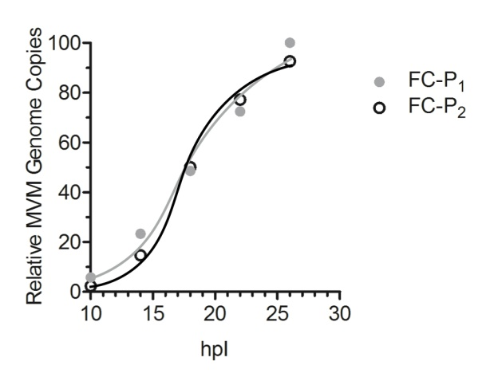
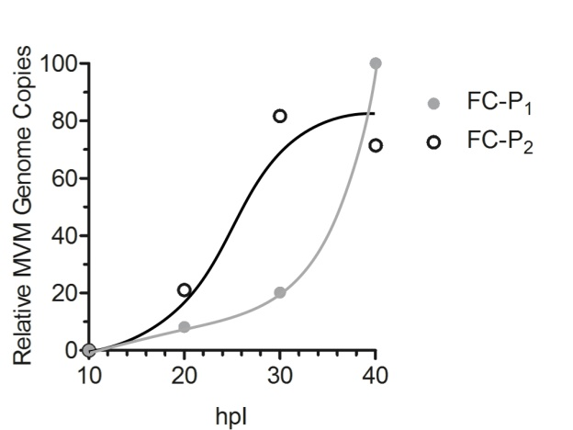
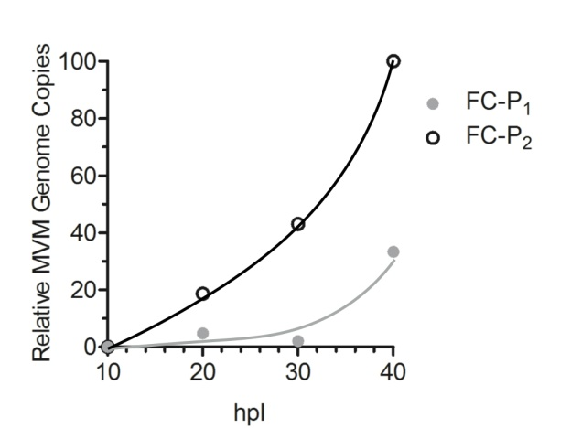
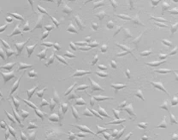
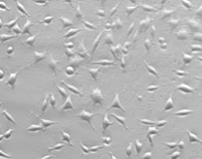
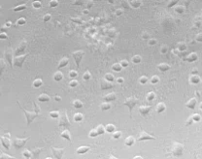
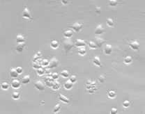
Fig. 4
A
B
C
D
10 h
20 h
30 h
99 %
100 %
40 h
98 %
58 %

Slide 5
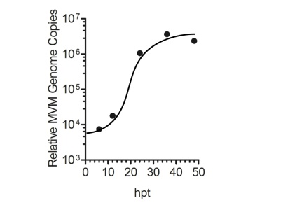
Fig. 5
A
A9
NB324K
B
NB324K
10 h
10 h
C
14 h
14 h
24 h
18 h
18 h
48 h

Slide 6
Fig. 6
A
B
C

Slide 7
Fig. 7
IF
WB
P2(NUC) / P2(SN) Stability

Slide 8
Fig. 8
Incoming virions
A9
5 min
6 h
6 h
+ BafA₁

